Slide 1
INTRODUCTION TO
{PYTHON PROGRAMMING}
Welcome Aboard!

Slide 2
LEARNING OUTCOME
At the end of this course, you will be able to develop and execute Python Programs
At the end of this course, you will be able to manipulate Data and perform operations
At the end of this course, you will be able to implement error handling and utilize python modules
At the end of this course, you will be able to interact with files and the filesystem

Slide 3
01
INTRODUCTION

Slide 4
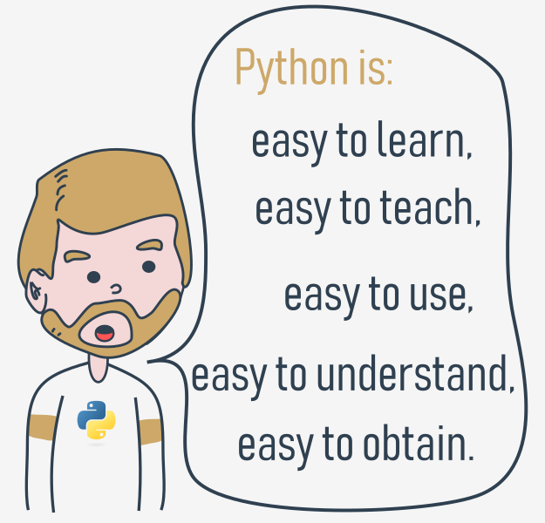
WHY PYTHON
Factors that make Python great for learning:
It is easy to learn
It is easy to use for writing new software
It is easy to obtain, install and deploy
Hundreds of Python libraries and frameworks (Pypi)
Big Data, Machine Language, Cloud Computing, and Automation
Mature and supportive Python community

Slide 5




PYTHON BEING USED?

Slide 6
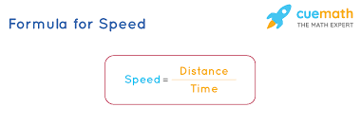
Computer Program Works
How does computer program WORKS?
A computer program makes a computer usable by instructing it to perform tasks. Without programs, computers are just objects. Computers can only execute simple operations like addition or division but can do so very quickly and repetitively.

Slide 7
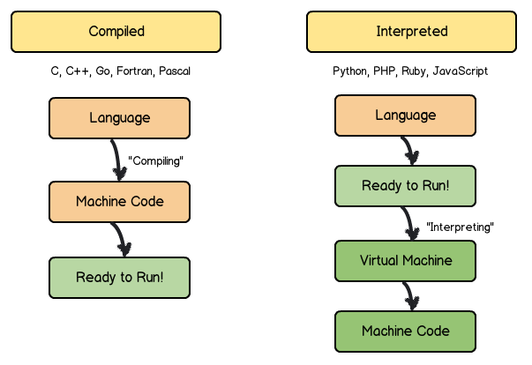
Compilation vs Interpretation
Compilation vs Interpretation

Slide 8
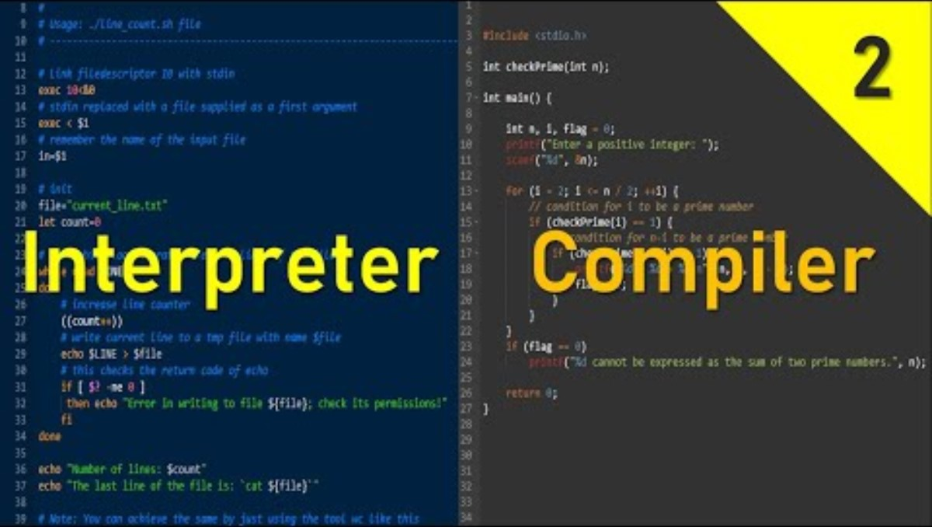
Compilation vs Interpretation

Slide 9
Compilation vs Interpretation
 | Compilation | Interpretation
Advantages | - Faster execution | - Immediate code execution
 | - End-user doesn't need compiler | - Portable across different architectures
 | - Code stored in machine language | - No separate compilation needed
 | - Protection of programming tricks | - Language flexibility
Disadvantages | - Time-consuming compilation process | - Slower execution due to interpreter
 | - Need for multiple compilers for platforms | - Dependency on interpreter for execution

Slide 10

What does It mean?

Slide 11
WHAT IS PYTHON
Python is an interpreted language
If you want to program in Python, you'll need the Python interpreter.

Slide 12


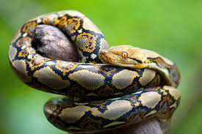
CREATOR OF PYTHON

Slide 13
in December 1989, I was looking for a "hobby" programming project that would keep me occupied during the week around Christmas. My office (...) would be closed, but I had a home computer, and not much else on my hands. I decided to write an interpreter for the new scripting language I had been thinking about lately: a descendant of ABC that would appeal to Unix/C hackers. I chose Python as a working title for the project, being in a slightly irreverent mood (and a big fan of Monty Python's Flying Circus).
-Guido van Rossum

Slide 14
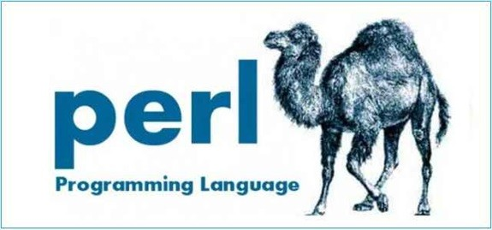
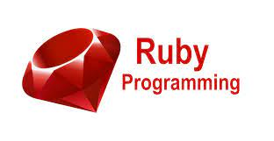
PYTHON RIVALS

Slide 15
WHY NOT PYTHON
low-level programming (sometimes called "close to metal" programming): if you want to implement an extremely effective driver or graphical engine, you wouldn't use Python.
applications for mobile devices: although this territory is still waiting to be conquered by Python, it will most likely happen someday.

Slide 16
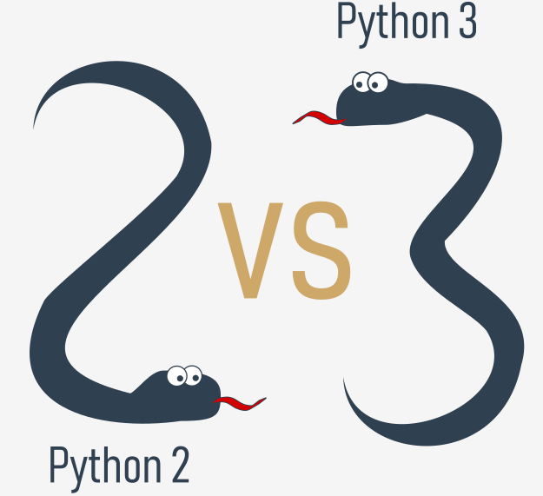
PYTHON VERSION
The course focuses on Python 3, as it is the current version and recommended for new projects.
Code samples in the course are tested against multiple versions of Python 3 to ensure compatibility.
Important differences between Python 3 versions may be highlighted throughout the course when necessary.

Slide 17
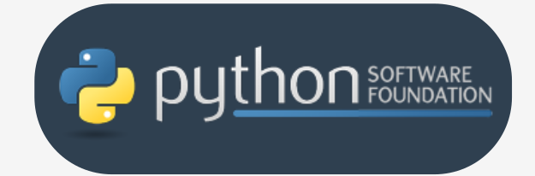
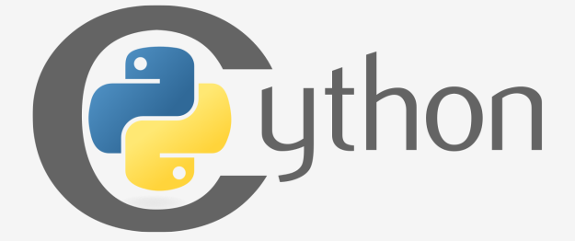
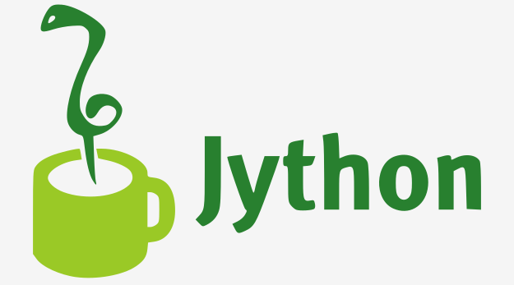
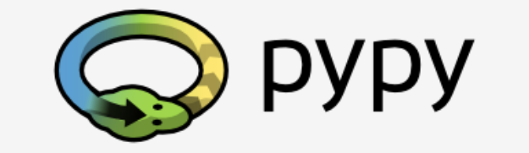
PYTHON VERSION

Slide 18
CPython
CPython is the primary implementation of Python maintained by the Python Software Foundation (PSF).
Guido van Rossum, the creator of Python, implemented the first version of Python using the C programming language, and this approach continues to be used in CPython.
CPython is considered the reference implementation of Python, as it follows all standards established by the PSF.
CPython is highly influential and widely used, as it can be easily ported and migrated to various platforms with the ability to compile and run C language programs.

Slide 19
Cython
Purpose: Addresses Python's lack of efficiency by translating Python code into C for faster execution.
Problem: Python can be slow for complex mathematical calculations.
Solution: Write code in Python, then use Cython to automatically translate it into C.
Process: Write Python code, compile with Cython into C, then compile C into a shared library or executable.
Benefits: Combines Python's ease of writing with C's efficiency, useful for performance-critical tasks and numerical computing.

Slide 20
Jython
Purpose: A version of Python implemented in Java, allowing seamless integration with Java environments.
Advantages: Facilitates communication with existing Java infrastructure, making it useful for projects developed in Java.
Use Cases: Particularly beneficial for large and complex systems written entirely in Java that require Python flexibility.
Compatibility: Current Jython implementations follow Python 2 standards, with no Jython version conforming to Python 3 standards available yet.

Slide 21
PyPy and Rpython
PyPy: A Python implementation written in RPython, a subset of Python.
RPython: A restricted subset of Python used to implement PyPy.
Execution: PyPy source code is translated into C and then executed separately, rather than being interpreted like CPython.
Usefulness: PyPy is useful for testing new features in Python implementations more easily than with CPython.
Compatibility: PyPy is compatible with Python 3 language features.
Focus of the Course: The course primarily focuses on CPython, but there are various other Python implementations in the world, including PyPy.

Slide 22
GETTING STARTED
Installing Python
Using IDLE and the basic interactive mode
Writing a simple program
Using Python shell
Installing and Using PyCharm

Slide 23
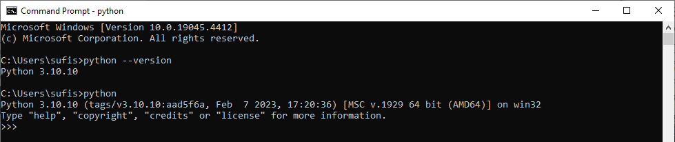
GETTING STARTED
Verify Python Installation:
On CMD: python --version / python

Slide 24
GETTING STARTED
Starting your Work:
editor which will support you in writing the code
console in which you can launch your newly written code and stop it forcibly when it gets out of control.
debugger able to launch your code step-by-step, which will allow you to inspect it at each moment of execution.
IDLE: Integrated Development and Learning Environment

Slide 25
VIRTUAL ENVIRONMENT
A virtual environment in Python is a self-contained directory that contains a Python interpreter and a set of libraries.
It allows you to isolate dependencies for different projects so they don’t interfere with each other.

Slide 26
HELLO WORLD
print("Hello, World!")

Slide 27
Print() Function
print() Function: A built-in function that outputs specified messages to the screen.
To call a function (this process is known as function invocation or function call
Escape Character: The backslash \ is used to introduce special characters like \n for a newline.
Formatting with print(): The ‘sep’ parameter specifies the separator between arguments, and the ‘end’ parameter defines what is printed at the end of the output

Slide 28
Literal
A literal in programming is a fixed value that you write directly in your code. It's a specific value that doesn't change, as opposed to variables which can hold different values over time.

Slide 29
Literal
Integer Literals: Numbers without a decimal point.
Example: 123, 0, -456
Floating-Point Literals: Numbers with a decimal point.
Example: 3.14, 0.001, -7.5
String Literals: Text enclosed in quotes.
Example: "Hello, world!", 'Python', "I'm learning“
Boolean Literals: The values True and False.
Example: True, False

Slide 30
Operator
+= Addition
-= Substraction
*= Multiplication
/= Division
//= Floor Division
%= Modulus
**= Exponentiation

Slide 31
Operator
Binary Operator
In subtracting applications, the minus operator expects two arguments: the left (a minuend in arithmetical terms) and right (a subtrahend). Subtraction consider Binary
Unary Operator
+2
-2

Slide 32
Operator
the hierarchy of priorities:
2+3*5 (Multiplication Precede Additions)
Bindings: (Most are LEFT-SIDED BINDING)
Print(9 % 6 % 2)
There are two possible ways of evaluating this expression:
from left to right: first 9 % 6 gives 3, and then 3 % 2 gives 1;
from right to left: first 6 % 2 gives 0, and then 9 % 0 causes a fatal error.
BODMAS

Slide 33
Operator
Bindings for Exponentiation:
Print(2 ** 2 ** 3)
the exponentiation operator uses right-sided binding.

Slide 34
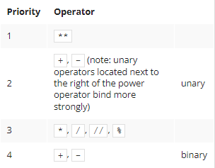
Operator

Slide 35
Operator
Example:
print(2 * 3 % 5) # If same priority it will start left-binding
Parentheses subexpressions in parentheses are always calculated first.:
print((5 * ((25 % 13) + 100) / (2 * 13)) // 2)

Slide 36
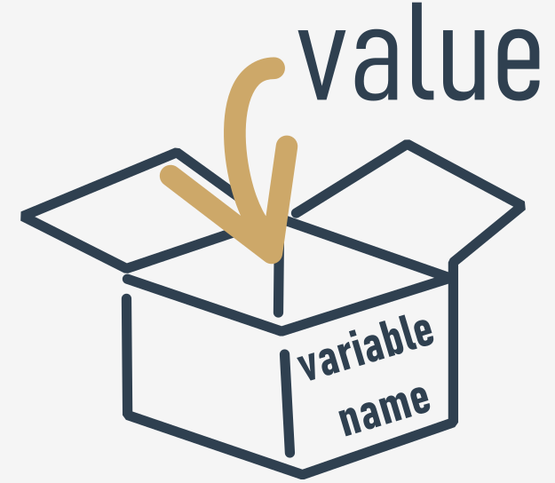
Variables
Key Features:
NAME & VALUE
num = 34

Slide 37
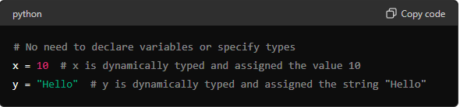
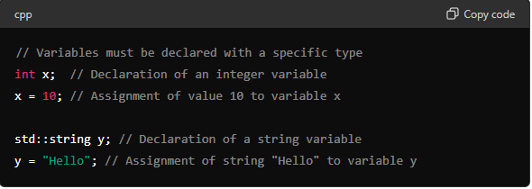
Variables
Python is Dynamically-Typed Language:

Slide 38
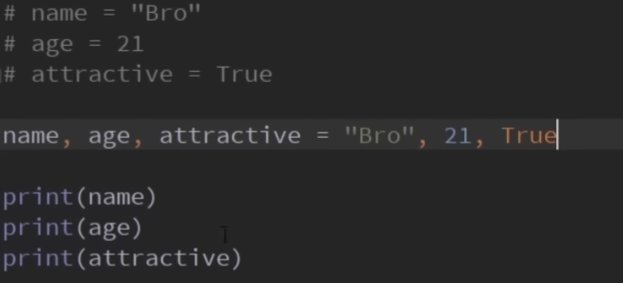
Variables
Multiple Assignment:
Allow us to assign multiple variables at the same time in one line of code

Slide 39
Variables
Naming Rules for Variables:
made up of letters (upper-case or lower-case), digits, and the underscore (_) character.
must begin with a letter (either upper-case or lower-case) or an underscore.
Python treats upper-case and lower-case letters as different, so var and Var are two different variables.
Variable names must not be any of Python's reserved words (keywords).

Slide 40
Variables
PEP 8 – Style Guide for Python Code:
variable names should be lowercase, with words separated by underscores to improve readability (e.g., var, my_variable)
function names follow the same convention as variable names (e.g., fun, my_function)
it's also possible to use mixed case (e.g., myVariable), but only in contexts where that's already the prevailing style.

Slide 41
Variables
Keyword or Reserved Keywords. They are reserved because you mustn't use them as names
False, None, True, and, as , assert, return, in, for etc..
You can use ‘Import’ but not ‘import’

Slide 42
Variables
Shorcut Operator:
X = x * 2 (x *= 2)
Sheep = sheep + 1 (sheep += 1)
i = i + 2 * j ⇒ i += 2 * j
var = var / 2 ⇒ var /= 2
rem = rem % 10 ⇒ rem %= 10
j = j - (i + var + rem) ⇒ j -= (i + var + rem)
x = x ** 2 ⇒ x **= 2

Slide 43
Variables
Variable Definition: A variable is a named memory location for storing values, automatically created upon assignment.
Identifiers: Variable names (identifiers) must be unique, begin with an underscore or letter, and cannot be Python keywords. They may include underscores, letters, and digits, and are case-sensitive.

Slide 44
Variables
Dynamic Typing: Python is dynamically-typed, meaning variable declaration is unnecessary. Assignment uses the equal sign (e.g., var = 1).
Compound Assignment Operators: These operators (e.g., +=, /=) modify variable values.
Reassignment: Variables can be reassigned using either the assignment operator or compound operators.

Slide 45
Comment
A remark inserted into the program, which is omitted at runtime, is called a comment. In Python, a comment is a piece of text that begins with a # (hash) sign
# This program evaluates the hypotenuse c.
# a and b are the lengths of the legs.
a = 3.0
b = 4.0
c = (a ** 2 + b ** 2) ** 0.5 # We use ** instead of square root.
print("c =", c)

Slide 46
Comment
You can comment multiple lines in Python using triple quotes (''' or """).
' ‘ ’
This is a multi-line comment in Python.
You can write comments spanning multiple lines
by enclosing them in triple quotes.
'‘’
print("Hello, World!")

Slide 47
Comment
You can comment multiple lines in Python using triple quotes (''' or """).
' ‘ ’
This is a multi-line comment in Python.
You can write comments spanning multiple lines
by enclosing them in triple quotes.
'‘’
print("Hello, World!")

Slide 48
INPUT()FUNCTION
Purpose: While print() outputs data to the console, input() retrieves data entered by the user.
Usage: The input() function is invoked without any arguments.
Variable Assignment: It's essential to assign the result of input() to a variable to capture the user's input. Without this step, the entered data will be lost.
Interactive Programs: input() enables the creation of interactive programs that can receive and process user input, making the code more dynamic and user-friendly.

Slide 49
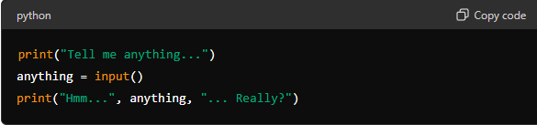
INPUT()FUNCTION
The program prompts the user to input data.
The input() function receives the inputted data (string) and assigns it to the variable anything.
The program then outputs the received data along with additional remarks.

Slide 50

INPUT()FUNCTION
Result of the input() function is a string
Must not use it as an argument of any arithmetic operation

Slide 51

TYPE CASTING
The float() function takes one argument a string: float(string) and tries to convert it into a float(the rest is the same)

Slide 52

TYPE CASTING
This type of conversion is not a one-way street. You can also convert a number into a string, which is way easier and safer ‒ this kind of operation is always possible. A function capable of doing that is called str():

Slide 53
CONCATENATION
The + (plus) sign, when applied to two strings, becomes a concatenation operator: (string + string)
For Replication is * (asterisk) Sign
It simply concatenates (glues) two strings into one
operator is not commutative, i.e., "ab" + "ba" is not the same as "ba" + "ab".
you must ensure that both its arguments are strings.

Slide 54
CONCATENATION
Replication:
The * (asterisk) sign, when applied to a string and number (or a number and string, as it remains commutative in this position) becomes a replication operator:
For example:
"James" * 3 = "JamesJamesJames"
3 * "an" = "ananan"
5 * "2" (or "2" * 5) gives "22222" (not 10!)

Slide 55
Core Concept
Language Semantic
VS
Scalar Types

Slide 56
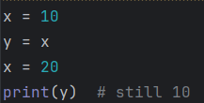
Language Semantic
Variables are references, not boxes
Python does not copy the value, x and y both refer to the same object (10)

Slide 57
Language Semantic
Python is Dynamically-Typed Language:

Slide 58

Language Semantic
Indentation defines code blocks:
No {} like other languages — spaces matter.

Slide 59

Language Semantic
Everything is an object:
Even numbers and functions:

Slide 60
02
FLOW CONTROL
& COLLECTION

Slide 61
Making Decision
A programmer writes a program and the program asks questions.
A computer executes the program and provides the answers. The program must be able to react according to the received answers.
Fortunately, computers know only two kinds of answers:
yes, this is true;
no, this is false.

Slide 62
Equality Operator
Question: are two values equal?
To ask this question, you use the == (equal equal) operator.
Don't forget this important distinction:
= is an assignment operator, e.g., a = b assigns a with the value of b;
== is the question are these values equal?; a ==b
compares a and b.

Slide 63
Equality Operator
2 == 2? # TRUE
2 == 2.0? # TRUE Python is able to convert the integer value into its real equivalent
1 == 2 # FALSE

Slide 64
Equality Operator
Inequality: the not equal to operator (!=)
The != (not equal to) operator compares the values of two operands, too. Here is the difference: if they are equal, the result of the comparison is False. If they are not equal, the result of the comparison is True.

Slide 65
Comparison Operator
Greater than >
Greater than or equal to >=
Less than or equal to <=
Less than <

Slide 66
Comparison Operator
What can you do with the answer (i.e., the result of a comparison operation) you get from the computer?
There are at least two possibilities: first, you can memorize it (store it in a variable) and make use of it later. How do you do that? Well, you would use an arbitrary variable like this:
answer = number_of_lions >= number_of_lionesses

Slide 67
Comparison Operator
Priority | Operator
1 | +, - | unary
2 | **
3 | *, /, //, %
4 | +, - | binary
5 | <, <=, >, >=
6 | ==, !=

Slide 68
LAB 7
Comparison

Slide 69
F-strings provide a concise and readable way to embed expressions inside string literals using {}.
CONDITIONS EXECUTION
You already know how to ask Python questions, but you still don't know how to make reasonable use of the answers. You have to have a mechanism which will allow you to do something if a condition is met, and not do it if it isn't.
if the_weather_is_good: go_for_a_walk() have_lunch()

Slide 70
F-strings provide a concise and readable way to embed expressions inside string literals using {}.
CONDITIONS EXECUTION
if the_weather_is_good: go_for_a_walk() have_lunch()
IDENTED

Slide 71
F-strings provide a concise and readable way to embed expressions inside string literals using {}.
IF Statement
We've said that conditionally executed statements have to be indented. This creates a very legible structure, clearly demonstrating all possible execution paths in the code.
if sheep_counter >= 120: make_a_bed() take_a_shower() sleep_and_dream() feed_the_sheepdogs()

Slide 72
if-else Statement
We can say, for example: If the weather is good, we will go for a walk, otherwise we will go to a theater.
Now we know what we'll do if the conditions are met, and we know what we'll do if not everything goes our way. In other words, we have a "Plan B".
if the_weather_is_good: go_for_a_walk() else: go_to_a_theater() have_lunch()

Slide 73
Nested if-else Statement
this use of the if statement is known as nesting; remember that every else refers to the if which lies at the same indentation level; you need to know this to determine how the ifs and elses pair up;
consider how the indentation improves readability and makes the code easier to understand and trace.
if the_weather_is_good: if nice_restaurant_is_found: have_lunch() else: eat_a_sandwich() else: if tickets_are_available: go_to_the_theater() else: go_shopping()

Slide 74
elif Statement
The second special case introduces another new Python keyword: elif. As you probably suspect, it's a shorter form of else if.
elif is used to check more than just one condition, and to stop when the first statement which is true is found.
if the_weather_is_good: go_for_a_walk() elif tickets_are_available: go_to_the_theater() elif table_is_available: go_for_lunch() else: play_chess_at_home()

Slide 75
elif Statement
The way to assemble subsequent if-elif-else statements is sometimes called a cascade.
you mustn't use else without a preceding if;
else is always the last branch of the cascade, regardless of whether you've used elif or not;
else is an optional part of the cascade, and may be omitted;
if there is an else branch in the cascade, only one of all the branches is executed;
if there is no else branch, it's possible that none of the available branches is executed.
.

Slide 76
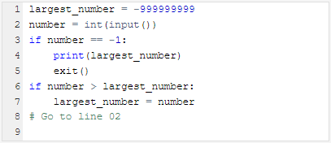
Intro to LOOPS
we'll use a kind of notation which is not an actual programming language (it can be neither compiled nor executed), but it is formalized, concise and readable. It's called pseudocode.

Slide 77
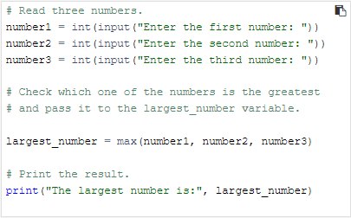
Intro to LOOPS
EXTRA INFO
Python often comes with a lot of built-in functions that will do the work for you. For example, to find the largest number of all, you can use a Python built-in function called max().

Slide 78
while Statement
Do you agree with the statement presented below
while there is something to do:
do it
The semantic difference is more important: when the condition is met, if performs its statements only once; while repeats the execution as long as the condition evaluates to True.

Slide 79
while Statement
while conditional_expression:
instruction_one
instruction_two
instruction_three
:
:
instruction_n
Indent all statements inside a while loop similarly, just like with if.
Instructions within the while loop are called. the loop's body
If the condition is False initially, the loop’s body is not executed.
The body should alter the condition's value to avoid an infinite loop.

Slide 80

Infinite Loop
An infinite loop, also called an endless loop, is a sequence of instructions in a program which repeat indefinitely (loop endlessly.)

Slide 81
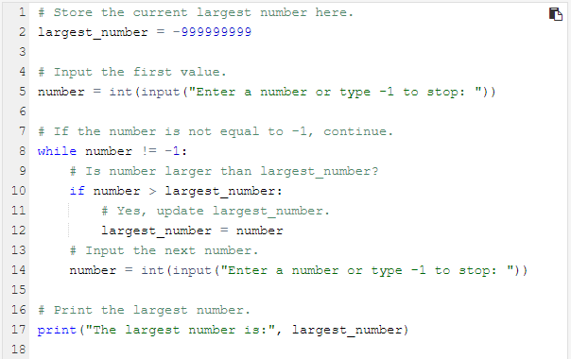
How The Body Exit?

Slide 82
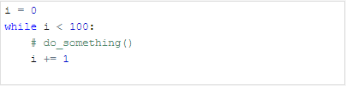
for Statement
Another kind of loop available in Python comes from the observation that sometimes it's more important to count the "turns" of the loop than to check the conditions. In While loop it looks like this:

Slide 83

for Statement
Actually, the for loop is designed to do more complicated tasks - it can "browse" large collections of data item by item.

Slide 84
for Statement
The for keyword starts a for loop; no condition is needed.
The variable after for is the control variable, automatically counting the loop's iterations.
The in keyword defines the range of values for the control variable.
The range() function generates values for the control variable, starting from 0 up to but not including the specified argument.
The pass keyword is used as a placeholder when no action is required in the loop body.

Slide 85

for Statement
the first argument determines the initial (first) value of the control variable. The last argument shows the first value the control variable will not be assigned.
the range() function accepts only integers as its arguments, and generates sequences of integers.
The first value shown is 2 (taken from the range()'s first argument.)
The last is 7 (although the range()'s second argument is 8).

Slide 86

for Statement
Range() function can accept three argument and it is for increment. The default value is 1
The Value of I is currently 2
The Value of I is currently 5

Slide 87
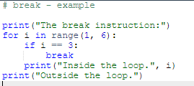
break Statement
break - exits the loop immediately, and unconditionally ends the loop's operation; the program begins to execute the nearest instruction after the loop's body;

Slide 88
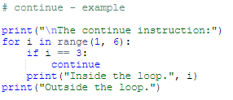
continue Statement
continue - behaves as if the program has suddenly reached the end of the body; the next turn is started and the condition expression is tested immediately.

Slide 89
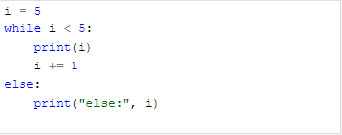
While and else Statement
As you may have suspected, loops may have the else branch too, like ifs.
The loop's else branch is always executed once, regardless of whether the loop has entered its body or not.

Slide 90
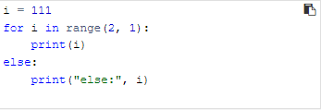
For else Statement
for loops behave a bit differently - take a look at the snippet in the editor and run it.
When the loop's body isn't executed, the control variable retains the value it had before the loop.

Slide 91
COMPUTER LOGIC
If we have some free time, and the weather is good, we will go for a walk.
If you are in the mall or I am in the mall, one of us will buy a gift for Mom.
and, or , not

Slide 92

COMPUTER LOGIC
One logical conjunction operator in Python is the word and. It's a binary operator with a priority that is lower than the one expressed by the comparison operators. It allows us to code complex conditions without the use of parentheses like this one:

Slide 93
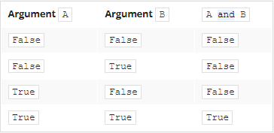
Logical operator: and

Slide 94
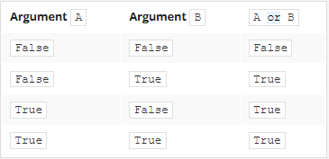
Logical operator: or

Slide 95
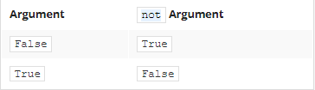
Logical operator: not

Slide 96
Bitwise Operator
However, there are four operators that allow you to manipulate single bits of data. They are called bitwise operators.
& (ampersand) - bitwise conjunction;
| (bar) - bitwise disjunction;
~ (tilde) - bitwise negation;
^ (caret) - bitwise exclusive or (xor).

Slide 97
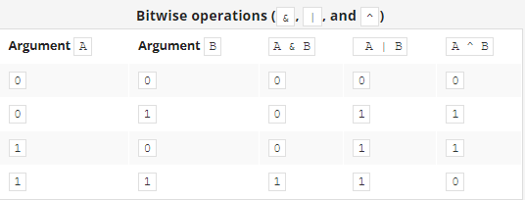
Bitwise Operator
& requires exactly two 1s to provide 1 as the result;
| requires at least one 1 to provide 1 as the result;
^ requires exactly one 1 to provide 1 as the result.

Slide 98
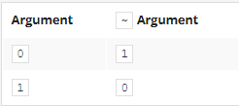
Bitwise Operator

Slide 99
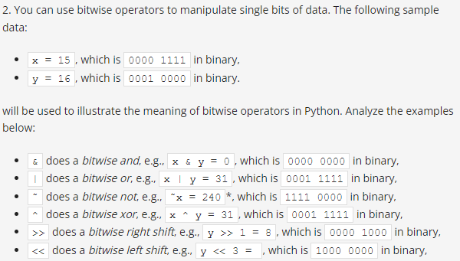
Bitwise Operator

Slide 100
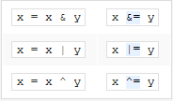
Bitwise Operator
Each of these two-argument operators can be used in abbreviated form. These are the examples of their equivalent notations:

Slide 101
Bit Shifting
Python offers yet another operation relating to single bits: shifting. This is applied only to integer values, and you mustn't use floats as arguments for it.
12345 x 10 = 123450 (Shift to the left and fill with 0)
12340 / 10 = 1234 (Shift to the right)

Slide 102

Shift Operator
The shift operators in Python are a pair of digraphs: << and >>, clearly suggesting in which direction the shift will act.
17 68 8

Slide 103
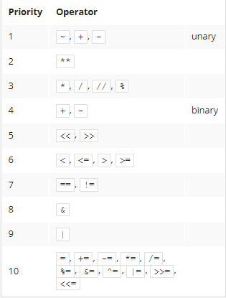
Shift Operator

Slide 104
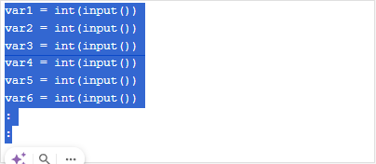
Why do we need List
Do you need to create a separate variable for each value?

Slide 105

Why do we need List
list starts with an open square bracket and ends with a closed square bracket
numbers is a list consisting of five values, all of them numbers.
The elements inside a list may have different types. Some of them may be integers, others floats, and yet others may be lists.
Indexable starting from [0]

Slide 106
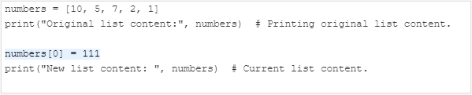
Indexing List
Original list content: [10, 5, 7, 2, 1]
New list content: [111, 5, 7, 2, 1]

Slide 107
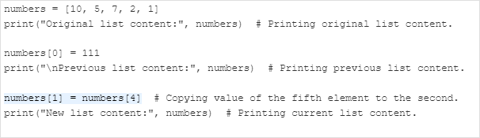
Indexing List
Original list content: [10, 5, 7, 2, 1]
Previous list content: [111, 5, 7, 2, 1]
New list content: [111, 1, 7, 2, 1]

Slide 108
Accessing List Content
Print(numbers[0]) # Accessing the lists first item
Print(numbers) # printing the whole list
Len(number) # printing the length of the list
numbers = [10, 5, 7, 2, 1] print("Original list content:", numbers) # Printing original list content. numbers[0] = 111 print("\nPrevious list content:", numbers) # Printing previous list content. numbers[1] = numbers[4] # Copying value of the fifth element to the second. print("Previous list content:", numbers) # Printing previous list content. print("\nList length:", len(numbers)) # Printing the list's length.

Slide 109
Removing element from list
Del number[0]
numbers = [10, 5, 7, 2, 1] del numbers[1] # Removing the second element from the list. print("New list's length:", len(numbers)) # Printing new list length. print("\nNew list content:", numbers) # Printing current list content.

Slide 110

Negative Indices
Print(number[-1])
An element with an index equal to -1 is the last one in the list.

Slide 111
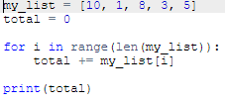
Making use of Lists
The for loop has a very special variant that can process lists very effectively - let's take a look at that.

Slide 112
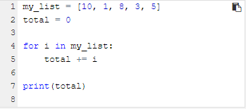
Making use of Lists
But the for loop can do much more. It can hide all the actions connected to the list's indexing, and deliver all the list's elements in a handy way.

Slide 113
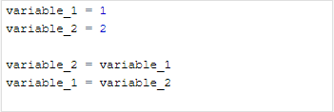
List in Action
Question: how can you swap the values of two variables?
Variable_2 will lost the value previously stored

Slide 114
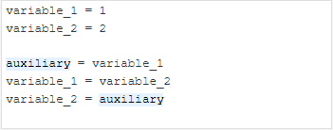

List in Action
Question: how can you swap the values of two variables?

Slide 115
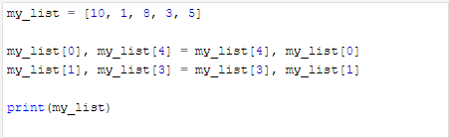
List in Action
Now you can easily swap the list's elements to reverse their order:

Slide 116
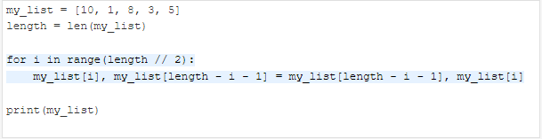
List in Action
Will it still be acceptable with a list containing 100 elements? No, it won't.

Slide 117

Nested List
just want you to be aware that something like this is possible, too. If u want to delete the value inside the nested list that have the value 64
Del my_list[2][1]

Slide 118

Inner Life of List
Lists (and many other complex Python entities) are stored in different ways than ordinary (scalar) variables.
The assignment: list_2 = list_1 copies the name of the array, not its contents. In effect, the two names (list_1 and list_2) identify the same location in the computer memory. Modifying one of them affects the other, and vice versa.
[2]

Slide 119
Slicing List
A slice is an element of Python syntax that allows you to make a brand new copy of a list, or parts of a list. It actually copies the list's contents, not the list's name.
my_list[start:end]
A slice of this form makes a new (target) list, taking elements from the source list - the elements of the indices from start to end - 1.

Slide 120
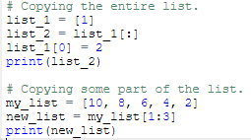
Slicing List
[1]
[8,6]

Slide 121

Slicing List (-)
To repeat:
start is the index of the first element included in the slice;
end is the index of the first element not included in the slice.
[8, 6, 4]

Slide 122

Slicing List (-)
If the start specifies an element lying further than the one described by the end (from the list's beginning point of view), the slice will be empty:
[]

Slide 123
Slicing List
my_list[:end] = it is assumed that you want to get a slice beginning at the element with index 0.
my_list[start:] = it is assumed that you want the slice to end at the element with the index len(my_list).
my_list[:] = copy of the whole list:
del my_list[start:end] = slice doesn't produce any new list!
del my_list[:] = Deleting all the elements at once give empty list []
del my_list = The del instruction will delete the list itself, not its content

Slide 124

In and not in operators
Python offers two very powerful operators, able to look through the list in order to check whether a specific value is stored inside the list or not

Slide 125



List Comprehension
The special syntax used by Python in order to fill massive lists.
A list comprehension is actually a list, but created on-the-fly during program execution, and is not described statically.

Slide 126
List Comprehension
two_d_squares = [[j ** 2 for j in range(4)] for _ in range(4)] print(two_d_squares)
[[0, 1, 4, 9], [0, 1, 4, 9], [0, 1, 4, 9], [0, 1, 4, 9]]

Slide 127
Built-in Sequence Functions
They are Python built-in functions that work on sequence types, such as:
list
tuple
string
range
(also works on other iterables like set, dict keys)
These functions don’t belong to the sequence (unlike methods such as .append()), but can be used on any sequence.

Slide 128

Built-in Sequence Functions
len() – Length of a sequence
Returns number of elements.

Slide 129

Built-in Sequence Functions
min() – Smallest element
Elements must be comparable.

Slide 130
Built-in Sequence Functions
max() – Largest element
Elements must be comparable.

Slide 131

Built-in Sequence Functions
sum() – Sum of numeric Elements
Not for strings

Slide 132

Built-in Sequence Functions
sorted() – Returns a sorted list
Works on any sequence, returns a new list.

Slide 133

Built-in Sequence Functions
reversed() — Reverse iterator
Does NOT modify the original sequence.

Slide 134


Built-in Sequence Functions
enumerate() — Index + value
Very useful in loops.

Slide 135


Built-in Sequence Functions
zip() — Combine sequences
Stops at the shortest sequence.

Slide 136

Built-in Sequence Functions
any() — Is any element True?

Slide 137

Built-in Sequence Functions
all() — Are all elements True?

Slide 138
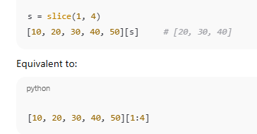
Built-in Sequence Functions
slice() — Create a slice object

Slide 139
03
FUNCTIONS

Slide 140
F-strings provide a concise and readable way to embed expressions inside string literals using {}.
Why do we need function
Enable code reuse, reducing redundancy.
Abstract away complex logic into named entities.
Promote modularity, making code easier to understand, test, and maintain.
Enhance readability by giving meaningful names to different parts of the code.
Facilitate testing by isolating specific functionality.
Encapsulate related functionality together, providing a clean interface.

Slide 141
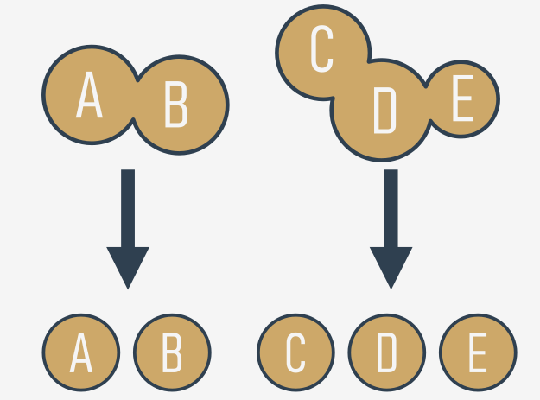
F-strings provide a concise and readable way to embed expressions inside string literals using {}.
Why do we need function
This considerably simplifies the work of the program, because each piece of code can be encoded separately, and tested separately. The process described here is often called decomposition.

Slide 142
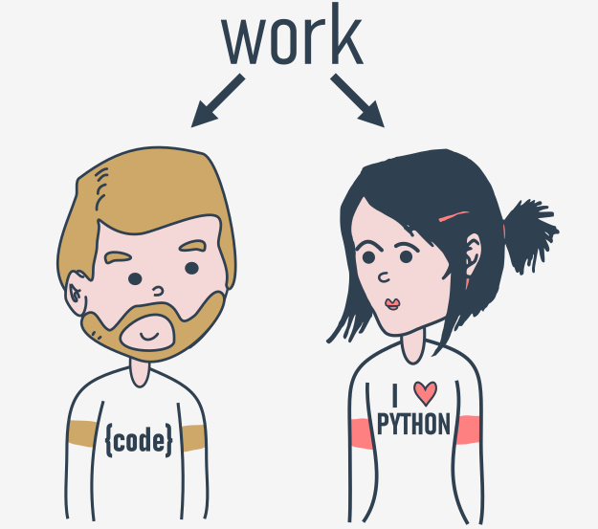
F-strings provide a concise and readable way to embed expressions inside string literals using {}.
Why do we need function
Decomposition in software development involves breaking down complex problems into smaller, manageable parts to facilitate collaboration among team members. This process allows multiple developers to work on different aspects simultaneously, sharing both the workload and responsibility.

Slide 143
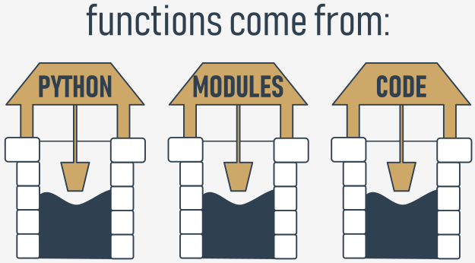
F-strings provide a concise and readable way to embed expressions inside string literals using {}.
Why do we need function
Functions, the core building blocks of software, can originate from various sources: built-in functions inherent to Python, functions within standard library modules, and user-defined functions defined by developers. Developers can effectively implement solutions to large problems while promoting code reusability and maintainability

Slide 144

F-strings provide a concise and readable way to embed expressions inside string literals using {}.
Your first Function
is it possible to separate such a repeatable part of the code, name it and make it reusable? It would mean that a change made once in one place would be propagated to all the places where it's used.

Slide 145

F-strings provide a concise and readable way to embed expressions inside string literals using {}.
Your first Function
Keyword def
Name of the function
Parantheses
Colon
Function body
function's invocation message()

Slide 146

F-strings provide a concise and readable way to embed expressions inside string literals using {}.
How Function Work

Slide 147

F-strings provide a concise and readable way to embed expressions inside string literals using {}.
How Function Work
You mustn't invoke a function which is not known at the moment of invocation.

Slide 148

F-strings provide a concise and readable way to embed expressions inside string literals using {}.
How Function Work
You mustn't have a function and a variable of the same name.

Slide 149

F-strings provide a concise and readable way to embed expressions inside string literals using {}.
How Function Work
Let's return to our primary example, and employ the function for the right job, like here:

Slide 150

F-strings provide a concise and readable way to embed expressions inside string literals using {}.
How Function Work
You can define a function which takes arguments, too, just like the one-parameter function below:

Slide 151

F-strings provide a concise and readable way to embed expressions inside string literals using {}.
Parameterized Functions
parameters exist only inside functions in which they have been defined, and the only place where the parameter can be defined is a space between a pair of parentheses in the def statement
Assigning a value to the parameter is done at the time of the function's invocation, by specifying the corresponding argument.

Slide 152
F-strings provide a concise and readable way to embed expressions inside string literals using {}.
Parameterized Functions
parameters exist only inside functions in which they have been defined, and the only place where the parameter can be defined is a space between a pair of parentheses in the def statement
Assigning a value to the parameter is done at the time of the function's invocation, by specifying the corresponding argument.

Slide 153

F-strings provide a concise and readable way to embed expressions inside string literals using {}.
Parameterized Functions
It's legal, and possible, to have a variable named the same as a function's parameter.
A situation like this activates a mechanism called shadowing
The parameter named number is a completely different entity from the variable named number.
Enter a number: 1
1234

Slide 154


F-strings provide a concise and readable way to embed expressions inside string literals using {}.
Parameterized Functions
A function can have as many parameters as you want, but the more parameters you have, the harder it is to memorize their roles and purposes.

Slide 155

F-strings provide a concise and readable way to embed expressions inside string literals using {}.
Positional Parameter
A technique which assigns the ith (first, second, and so on) argument to the ith (first, second, and so on) function parameter is called positional parameter passing, while arguments passed in this way are named positional arguments.

Slide 156

F-strings provide a concise and readable way to embed expressions inside string literals using {}.
Keyword Argument Passing
Python offers another convention for passing arguments, where the meaning of the argument is dictated by its name, not by its position - it's called keyword argument passing.

Slide 157

F-strings provide a concise and readable way to embed expressions inside string literals using {}.
Arbitrary Argument Passing
Parameter that will pack all arguments into a dictionary
Useful so that a function can accept a varying amount of keyword argument
**kwargs or **

Slide 158

F-strings provide a concise and readable way to embed expressions inside string literals using {}.
Arbitrary Argument Passing
Parameter that will pack all arguments into a tuple
Useful so that a function can accept a varying amount of argument
*args

Slide 159
To get functions to return a value (but not only for this purpose) you use the return instruction.
Return Instruction
To get functions to return a value (but not only for this purpose) you use the return instruction.
There is 2 variant return without expression and return with expression

Slide 160

To get functions to return a value (but not only for this purpose) you use the return instruction.
Return Instruction
Return without expression
When used inside a function, it causes the immediate termination of the function's execution, and an instant return (hence the name) to the point of invocation.

Slide 161

To get functions to return a value (but not only for this purpose) you use the return instruction.
Return Instruction
Return with expression
it causes the immediate termination of the function's execution (nothing new compared to the first variant)
moreover, the function will evaluate the expression's value and will return (hence the name once again) it as the function's result

Slide 162

To get functions to return a value (but not only for this purpose) you use the return instruction.
Return Instruction
The result may be freely used here, e.g., to be assigned to a variable.

Slide 163

To get functions to return a value (but not only for this purpose) you use the return instruction.
Return Instruction
The result may be freely used here, e.g., to be assigned to a variable.
This lesson is interesting!
'Boredom Mode' ON.
This lesson is boring...

Slide 164
To get functions to return a value (but not only for this purpose) you use the return instruction.
None Value
Its data doesn't represent any reasonable value - actually, it's not a value at all; hence, it mustn't take part in any expressions.
None is a keyword.
There are only two kinds of circumstances when None can be safely used:
when you assign it to a variable (or return it as a function's result)
when you compare it with a variable to diagnose its internal state.

Slide 165

None Value
Don't forget this: if a function doesn't return a certain value using a return expression clause, it is assumed that it implicitly returns None.

Slide 166

None Value
Print(strange_function(2))
Print(strange_function(1))
True
None

Slide 167

Simple Function: BMI

Slide 168

Simple Function: Factorial

Slide 169

Simple Function: Fibonacci

Slide 170

Recursion
recursion is a technique where a function invokes itself.
The Fibonacci numbers definition is a clear example of recursion.

Slide 171

Recursion
Can make it more simplified

Slide 172
List and Function
There are two additional questions that should be answered here.
The first is: may a list be sent to a function as an argument?
The second question is: may a list be a function result?

Slide 173

List and Function
The first is: may a list be sent to a function as an argument?
12

Slide 174

List and Function
The second question is: may a list be a function result?
[4, 3, 2, 1, 0]

Slide 175
LAB 20
Leap Year Function

Slide 176
LAB 21
Prime Number

Slide 177

Function and Scopes
The scope of a name (e.g., a variable name) is the part of a code where the name is properly recognizable.
For example, the scope of a function's parameter is the function itself. The parameter is inaccessible outside the function.

Slide 178

Function and Scopes
The answer is: a variable existing outside a function has a scope inside the functions' bodies.
Do I know that variable? 1
1

Slide 179

Function and Scopes
Do I know that variable? 2
1

Slide 180
Function and Scopes
A variable existing outside a function has a scope inside the functions' bodies, excluding those of them which define a variable of the same name.
It also means that the scope of a variable existing outside a function is supported only when getting its value (reading). Assigning a value forces the creation of the function's own variable.

Slide 181
Such an effect is caused by a keyword named global:
Function and Scopes: global
here's a special Python method which can extend a variable's scope in a way which includes the functions' bodies (even if you want not only to read the values, but also to modify them).
Such an effect is caused by a keyword named global

Slide 182

Such an effect is caused by a keyword named global:
Function and Scopes: global
here's a special Python method which can extend a variable's scope in a way which includes the functions' bodies (even if you want not only to read the values, but also to modify them).
Such an effect is caused by a keyword named global
Do I know that variable? 2
2

Slide 183

Such an effect is caused by a keyword named global:
Function Inside Function
In Python, you can define a function inside another function. These are sometimes called nested functions or inner functions.
Note: inner_function() is not accessible outside of outer_function().
Calling the inner function from outer:
Hello from the inner function!

Slide 184

Such an effect is caused by a keyword named global:
Function Inside Function
The inner function has access to variables in the outer function’s scope.
But the outer function cannot access variables inside the inner function

Slide 185

Such an effect is caused by a keyword named global:
Function as parameters
In Python, functions are first-class objects. This means:
You can pass functions as arguments to other functions,
Return them from functions,
Store them in variables or data structures.
Hello!

Slide 186


Such an effect is caused by a keyword named global:
Function Returning Function
outer(x) is a function that defines another function inside it: inner(y)
Instead of calling inner, it returns the function inner itself
inner has access to the variable x even after outer has finished running — this is called a closure

Slide 187

Such an effect is caused by a keyword named global:
Function Returning Function
Closure!
A closure happens when a nested function "remembers" the values from its enclosing function even after that function has finished.

Slide 188

Lambdas Expression
Lambda expressions, also known as anonymous functions, are small, unnamed functions defined using the lambda keyword.

Slide 189

Lambdas Expression
The declaration of the lambda function doesn't resemble a normal function declaration in any way - see for yourself:

Slide 190

Lambdas Expression
The declaration of the lambda function doesn't resemble a normal function declaration in any way - see for yourself:

Slide 191

Lambdas Expression
Lambda functions can be particularly useful when used in higher-order functions, such as map(), filter(), and sorted().

Slide 192

Such an effect is caused by a keyword named global:
Generator
It looks strange, doesn't it? It's clear that the for loop has no chance to finish its first execution, as the return will break it irrevocably.
We can say that such a function is not able to save and restore its state between subsequent invocations.
This also means that a function like this cannot be used as a generator.

Slide 193

Such an effect is caused by a keyword named global:
Generator
Generator functions allow you to declare a function that behaves like an iterator. They use the yield keyword instead of return to produce a series of values over time, one at a time, and in a lazy fashion.
This little amendment turns the function into a generator,

Slide 194
01
COLLECTION
TUPLE

Slide 195
Such an effect is caused by a keyword named global:
TUPLE
Sequence Types
Definition: Sequence types in Python are data types that can store more than one value and can be iterated through element by element using a for loop.
Example: The list is a classic example of a Python sequence.
Mutability
Mutable Data: Data that can be freely changed during program execution. Lists are an example of mutable data, as you can modify them in situ (e.g., list.append(1)).
Immutable Data: Data that cannot be modified in situ. Any changes require the creation of a new data structure. Tuples are an example of immutable data.

Slide 196

Such an effect is caused by a keyword named global:
TUPLE
tuples prefer to use parenthesis, whereas lists like to see brackets, although it's also possible to create a tuple just from a set of values separated by commas.

Slide 197

Such an effect is caused by a keyword named global:
How to use TUPLE
If you want to get the elements of a tuple in order to read them over, you can use the same conventions to which you're accustomed while using lists.

Slide 198

Such an effect is caused by a keyword named global:
How to use TUPLE
The similarities may be misleading - don't try to modify a tuple's contents! It's not a list!
All of these instructions (except the topmost one) will cause a runtime error:

Slide 199

Such an effect is caused by a keyword named global:
How to use TUPLE
Len() – return number of element
+ = can join tuples together
* = multiply tuples
In/not in = for expression

Slide 200

Such an effect is caused by a keyword named global:
How to use TUPLE
One of the most useful tuple properties is their ability to appear on the left side of the assignment operator.

Slide 201
01
COLLECTION
DICTIONARY

Slide 202
Such an effect is caused by a keyword named global:
DICTIONARY
The dictionary is another Python data structure. It's not a sequence type (but can be easily adapted to sequence processing) and it is mutable.

Slide 203
In Python's world, the word you look for is named a key. The word you get from the dictionary is called a value.
DICTIONARY
In Python's world, the word you look for is named a key. The word you get from the dictionary is called a value
Definition: A dictionary is a set of key-value pairs.
Unique Keys: Each key must be unique.
Key Types: Keys can be any immutable type (e.g., numbers, strings), but not lists.
Comparison to Lists: Unlike lists, which have ordered values, dictionaries hold pairs of values.
Length: The len() function returns the number of key-value pairs in a dictionary.
One-Way Tool: Dictionaries allow lookup of values based on keys, but not vice versa (e.g., English-French dictionary only allows English to French lookup).

Slide 204

In Python's world, the word you look for is named a key. The word you get from the dictionary is called a value.
How to make a DICTIONARY
The list of pairs is surrounded by curly braces, while the pairs themselves are separated by commas, and the keys and values by colons.

Slide 205

How to use a DICTIONARY
If you want to get any of the values, you have to deliver a valid key value:
print(dictionary['cat'])
print(phone_numbers['Suzy'])

Slide 206

How to use a DICTIONARY
And now the most important news: you mustn't use a non-existent key.
Fortunately, there's a simple way to avoid such a situation. The in operator, together with its companion, not in, can salvage this situation.

Slide 207

How to use a DICTIONARY
Cat -> chat
Lion is not in dictionary
Horse -> cheval

Slide 208
How to use a DICTIONARY
Can dictionaries be browsed using for loop, like lists or tuples?
NO:
Because a dictionary is not a sequence type - the for loop is useless with it.
YES:
Because there are simple and very effective tools that can adapt any dictionary to the for loop requirements

Slide 209

How to use a DICTIONARY
The first of them is a method named keys(), possessed by each dictionary. The method returns an iterable object consisting of all the keys gathered within the dictionary. Having a group of keys enables you to access the whole dictionary in an easy and handy way.

Slide 210

How to use a DICTIONARY
There is also a method named values(), which works similarly to keys(), but returns values.
As the dictionary is not able to automatically find a key for a given value, the role of this method is rather limited.

Slide 211

How to use a DICTIONARY
items() method
The method returns tuples (this is the first example where tuples are something more than just an example of themselves) where each tuple is a key-value pair.

Slide 212

How to use a DICTIONARY
Modifying:
Assigning a new value to an existing key is simple - as dictionaries are fully mutable, there are no obstacles to modifying them.

Slide 213


How to use a DICTIONARY
Adding and update():
Adding a new key-value pair to a dictionary is as simple as changing a value - you only have to assign a value to a new, previously non-existent key.

Slide 214

How to use a DICTIONARY
Remove a key():
Removing a key will always cause the removal of the associated value. Values cannot exist without their keys.

Slide 215

How to use a DICTIONARY
Remove last item in dictionary:
To remove the last item in a dictionary, you can use the popitem().

Slide 216
01
COLLECTION
SET

Slide 217

SET
Sets are used to store multiple items in a single variable.
A set is a collection which is unordered, unchangeable*, and unindexed.
Set are written in curly bracket
Sets are unordered, so you cannot be sure in which order the items will appear.

Slide 218

SET
Duplicates Not Allowed
The values True and 1 are considered the same value in sets, and are treated as duplicates:
Same goes to False and 0

Slide 219

SET
Access Items
You cannot access items in a set by referring to an index or a key.
But you can loop through the set items using a for loop, or ask if a specified value is present in a set, by using the in keyword.
Duplicate Values | Allowed | Allowed | Keys: Not allowed, Values: Allowed | Not allowed | Allowed
Syntax | [ ] | ( ) | { key: value, ... } | { } | ' ', " "
Access by Index | Yes | Yes | No (Access by key) | No | Yes
Modification | Add, Remove, Update | Not applicable | Add, Remove, Update | Add, Remove, Update | Not applicable
Iteration | Yes | Yes | By key, value, or items | Yes | Yes
Property | List | Tuple | Dictionary | Set | String
Data Type | Mutable | Immutable | Mutable | Mutable | Immutable
Ordered | Yes | Yes | No | No | Yes

Slide 220

SET
Add Set Items
Once a set is created, you cannot change its items, but you can add new items.
Duplicate Values | Allowed | Allowed | Keys: Not allowed, Values: Allowed | Not allowed | Allowed
Syntax | [ ] | ( ) | { key: value, ... } | { } | ' ', " "
Access by Index | Yes | Yes | No (Access by key) | No | Yes
Modification | Add, Remove, Update | Not applicable | Add, Remove, Update | Add, Remove, Update | Not applicable
Iteration | Yes | Yes | By key, value, or items | Yes | Yes
Property | List | Tuple | Dictionary | Set | String
Data Type | Mutable | Immutable | Mutable | Mutable | Immutable
Ordered | Yes | Yes | No | No | Yes

Slide 221

SET
Add Set Items update() Method
Once a set is created, you cannot change its items, but you can add new items. It can be any iterable object (tuples, list, dictionaries)
Duplicate Values | Allowed | Allowed | Keys: Not allowed, Values: Allowed | Not allowed | Allowed
Syntax | [ ] | ( ) | { key: value, ... } | { } | ' ', " "
Access by Index | Yes | Yes | No (Access by key) | No | Yes
Modification | Add, Remove, Update | Not applicable | Add, Remove, Update | Add, Remove, Update | Not applicable
Iteration | Yes | Yes | By key, value, or items | Yes | Yes
Property | List | Tuple | Dictionary | Set | String
Data Type | Mutable | Immutable | Mutable | Mutable | Immutable
Ordered | Yes | Yes | No | No | Yes

Slide 222

SET
Remove Item using remove() or discard()
If the item to remove does not exist, remove() will raise an error
You can remove an item using pop() method but it will random because set is unordered
Duplicate Values | Allowed | Allowed | Keys: Not allowed, Values: Allowed | Not allowed | Allowed
Syntax | [ ] | ( ) | { key: value, ... } | { } | ' ', " "
Access by Index | Yes | Yes | No (Access by key) | No | Yes
Modification | Add, Remove, Update | Not applicable | Add, Remove, Update | Add, Remove, Update | Not applicable
Iteration | Yes | Yes | By key, value, or items | Yes | Yes
Property | List | Tuple | Dictionary | Set | String
Data Type | Mutable | Immutable | Mutable | Mutable | Immutable
Ordered | Yes | Yes | No | No | Yes

Slide 223
Join SET
There are several ways to join two or more sets in Python.
The union() and update() methods joins all items from both sets.
The intersection() method keeps ONLY the duplicates.
The difference() method keeps the items from the first set that are not in the other set(s).
The symmetric_difference() method keeps all items EXCEPT the duplicates.
Duplicate Values | Allowed | Allowed | Keys: Not allowed, Values: Allowed | Not allowed | Allowed
Syntax | [ ] | ( ) | { key: value, ... } | { } | ' ', " "
Access by Index | Yes | Yes | No (Access by key) | No | Yes
Modification | Add, Remove, Update | Not applicable | Add, Remove, Update | Add, Remove, Update | Not applicable
Iteration | Yes | Yes | By key, value, or items | Yes | Yes
Property | List | Tuple | Dictionary | Set | String
Data Type | Mutable | Immutable | Mutable | Mutable | Immutable
Ordered | Yes | Yes | No | No | Yes

Slide 224

Join SET
The union() method returns a new set with all items from both sets.

Slide 225

Join SET
Join a set with a tuple

Slide 226

Join SET
The intersection() method will return a new set, that only contains the items that are present in both sets. ‘&’ operator consider the same

Slide 227

Join SET
The difference() method will return a new set that will contain only the items from the first set that are not present in the other set.
‘-’ operator works the same

Slide 228

Join SET
The symmetric_difference() method will keep only the elements that are NOT present in both sets. ‘^’ operator works the same

